Slide 1


<Wei Wan>
<12th May 2022>

Slide 2

Outline
Executive Summary
Introduction
Methodology
Results
Conclusion
Appendix

Slide 3
Executive Summary
Summary of Methodologies
Data Collection
Data Wrangling
Exploratory Data Analysis (EDA) with SQL
EDA with Data Visualization
Interactive Visual Analytics with Folium
Building a Dashboard with Plotly Dash
Prediction analysis (Classification)
Summary of Results
EDA results
Interactive Analytics
Predictive Analytics

Slide 4
Introduction
Project background and context
Falcon 9 rocket launches with a cost of 62 million dollars on SpaceX website because of reusing the first stage.
Other provides costs upwards of 165 million dollars each
Problems you want to find answers
Determine factors for landing successfully
Interact amongst various features to determine the success rate of a successful landing
Predict if the first stage of the SpaceX Falcon 9 rocket will land successfully so that we can determine the cost of a launch

Slide 5

Section 1

Slide 6
Methodology
Executive Summary
Data collection methodology:
Using SpaceX Rest API
Web Scrapping from Wikipedia
Perform data wrangling
One-hot encoding was applied to categorical features
Perform exploratory data analysis (EDA) using visualization and SQL
Perform interactive visual analytics using Folium and Plotly Dash
Perform predictive analysis using classification models
LR, KNN, SVM, DT models have been built and evaluated for the best classifier

Slide 7
Data Collection
Data sets were collected using SpaceX Rest API.
Collecting the data using get requests to the SpaceX API
Decoding the response content to a pandas DataFrame with .json_normalize()
Filtering the data to keep only Falcon 9 launches
Cleaning the data, checking for missing values and fill in missing values
Save the data frame to csv file for future analysis
Web Scrapping from Wikipedia
Collecting the data using get requests from wikipedia
Parsing beautifulSoup object from HTML response using html parser
Creating a pandas DataFrame by parsing the HTML tables
Save the data frame to csv file for future analysis

Slide 8

Data Collection – SpaceX API
Example codes:
Collecting the data using get requests
Decoding the response content to a pandas DataFrame
Filtering the data to keep only Falcon 9 launches
Cleaning the data, checking for missing values and fill in missing values
Save the data frame to csv file for future analysis
GitHub URL to link Notebook

Slide 9
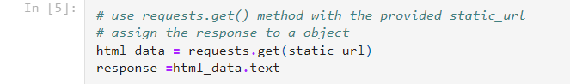
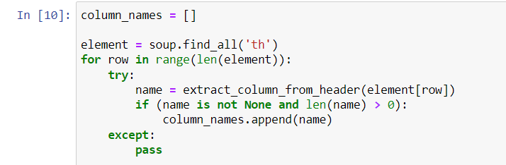
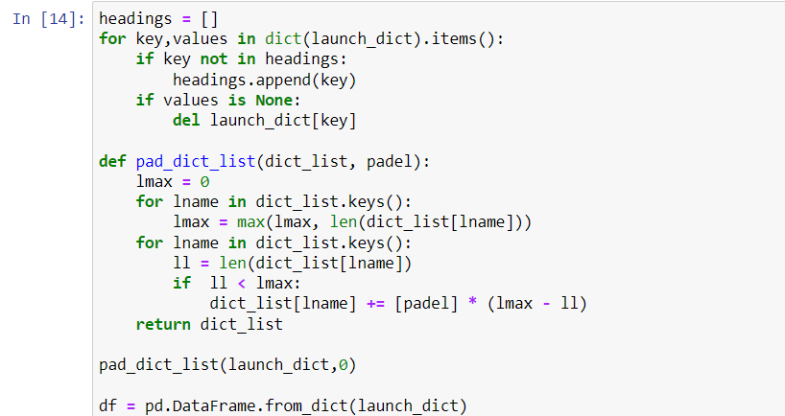
Data Collection - Scraping
Collecting the data using get requests from wikipedia
Parsing beautifulSoup object from HTML response using html parser
Extract column/variable names from the HTML table header
Creating a pandas DataFrame by parsing the HTML tables
Save the data frame to csv file for future analysis
GitHub URL to link Notebook

Slide 10

Data Wrangling
Introduction:
Explore data to find patterns in the data and determine what would be the label for training supervised models. In the data set, there are several different cases where the booster did not land successfully. After data wrangling, we convert those outcomes into Training labels with 1 means the booster successfully landed 0 means it was unsuccessful.
Key Phrases
Perform exploratory data analysis (EDA) on dataset
Calculate the number of launches at each site
Calculate the number and occurrence of each orbit
Calculate the number and occurrence of mission outcome per orbit type
GitHub URL to link Notebook

Slide 11
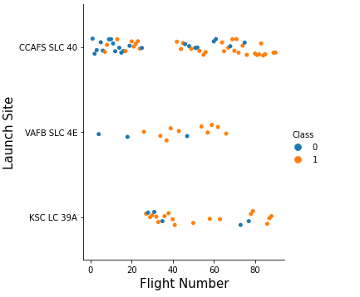


EDA with Data Visualization
Scatter Graphs
Flight Number VS. Payload Mass/Launch Site
Payload VS. Launch Site/Orbit Type
Orbit VS. Flight Number/Payload Mass
Bar Graph
Mean VS. Orbit
Line Graph
Success Rate VS. Year
Scatter plots show how one variable is affected by another. They usually consist of a large body of data.
A bar diagram makes it easy to compare sets of data between groups at a glace. The graph represents categories on one axis and a discrete value in the other.
Line graphs are useful in that they show data variables and trends very clearly and can help to make predictions about the results of data not yet recoded
GitHub URL to link Notebook

Slide 12
EDA with SQL
Displaying the names of the unique launch sites in the space mission
Displaying 5 records where launch sites begin with the string ‘KSC’
Displaying the total payload mass carried by boosters launched by NASA (CRS)
Displaying average payload mass carried by booster version F9 v1.1
Listing the date where the successful landing outcome in drone ship was achieved
Listing the names of the boosters which have success in ground pad and have payload mass greater than 4000 but less than 6000
Listing the total number of the booster_versions which have have carried the maximum payload mass
Listing the records which will display the month names, successful landing_outcomes in ground pad, booster versions, launch_site for the months in year 2017
Ranking the count of successful landing_outcomes between the date 2010-06-04 and 2017-03-20 in descending order
GitHub URL to link SQL SCRIPTS

Slide 13
Build an Interactive Map with Folium
Added the latitude and longitude coordinates of each launch site as a circle marker around launch site with a label of the name of the launch site.
Assigned the dataframe launch_outcomes to classes 1 (successful) and 0 (failed) with Green and Red markers on the map in a MarkerCluster()
Calculated the distance from the launch site to various landmarks to find various trends about what is around the Launch Site to measure patterns. Lines are drawn on the map to measure distance to landmarks.
Explore the map about launch sites proximity: close to a coast, near to the equator line, not close to railways and highway, far from cities, etc.
GitHub URL to link Notebook

Slide 14
Build a Dashboard with Plotly Dash
Perform interactive visual analytics on SpaceX launch data in real-time.
The dashboard is built with Plotly Dash web framework.
Success-pie-chart is plotted based on selected site dropdown
Display relative proportions of multiple classes of data
Size of the circle can be made proportional to the total quantity it represents
Success-payload-scatter-chart is plotted with Outcome and Payload Mass (Kg) for the different Booster Versions
Showing the relationship between two variables
Showing a non-linear pattern
GitHub URL to link source code

Slide 15
Predictive Analysis (Classification)
Evaluation
Check accuracy
Building Model
Data processing
Decide ML Algos
Get tuned hyperparameters
Finding the best performance classification model
Load dataset
Set Parameters
Plot confusion Matrix
Transform data
Training the model with training data
Split training & testing data
Improvement
Parameter tuning
Training the model
GitHub URL to link Notebook

Slide 16
Results
Exploratory data analysis results
Interactive analytics demo in screenshots
Predictive analysis results

Slide 17

Section 2

Slide 18
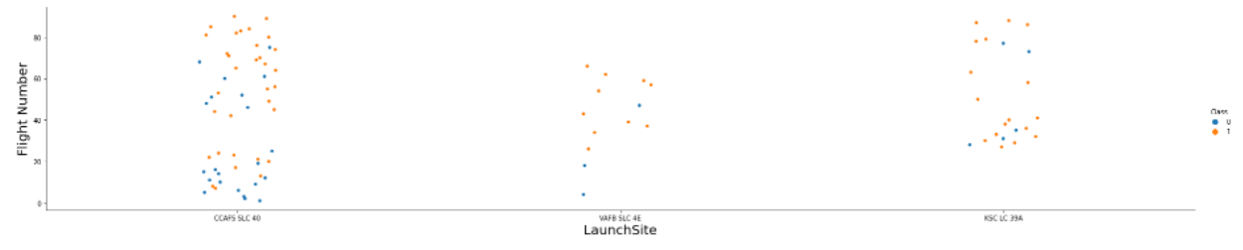
Flight Number vs. Launch Site
The more amount of flights at a launch site the greater the success rate at a launch site

Slide 19
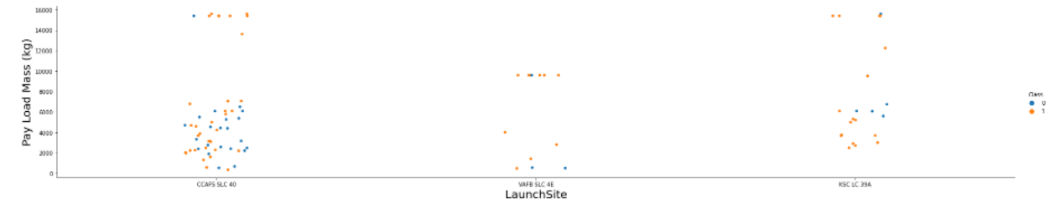
Payload vs. Launch Site
Launch Site CCAFS SLC 40 and VAFB SLC 4E show clearly the higher the success rate for the Rocket for the greater the payload mass.

Slide 20
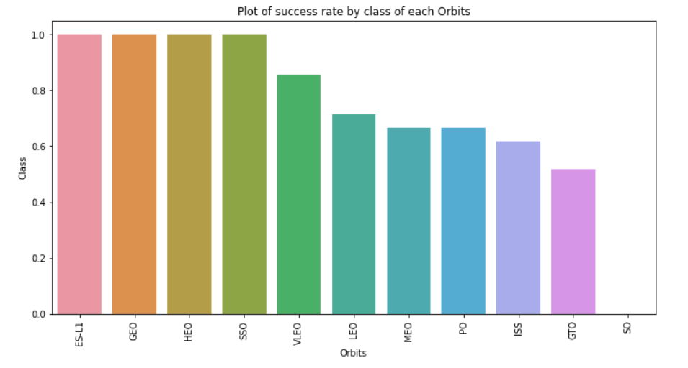
Success Rate vs. Orbit Type
Orbit ES-L1, GEO, HEO, SSO have the best Success Rate

Slide 21
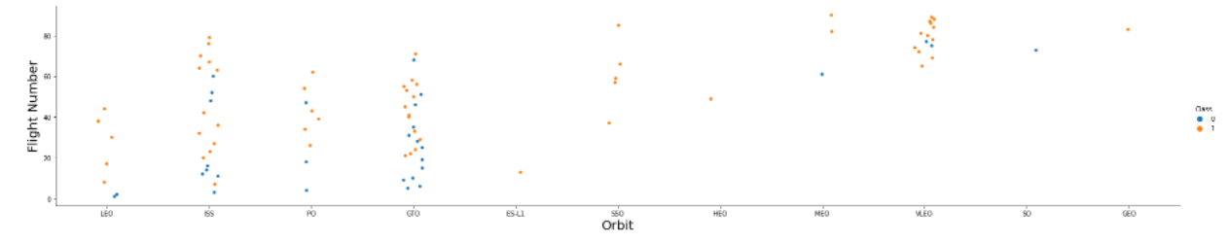
Flight Number vs. Orbit Type
The plot shows that in the LE) orbit the Success appears related to the number of flights. However, there is not relationship between flight number and successful rate in GTO orbit

Slide 22
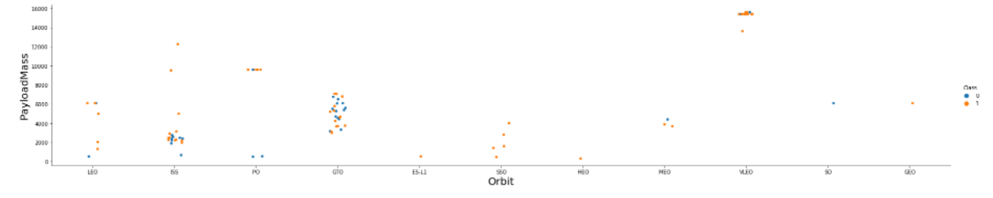
Payload vs. Orbit Type
The plot shows that with heavy payloads, the successful landing are more for LEO and ISS orbits. However, there is not clear relationship on GTO orbits

Slide 23
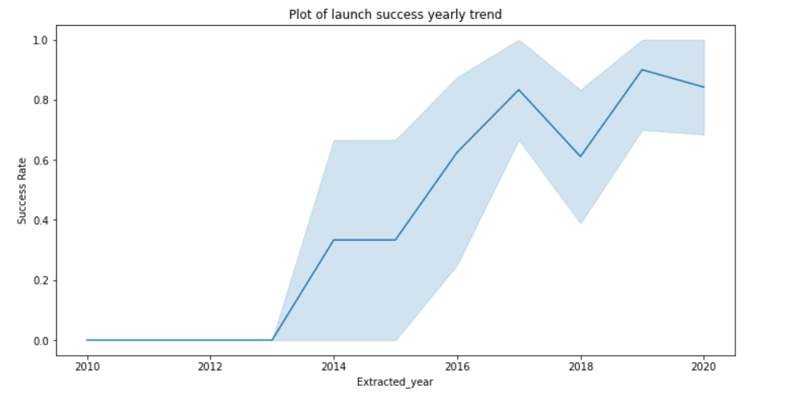
Launch Success Yearly Trend
We can observe that the trend of success rate is increasing after 2013

Slide 24
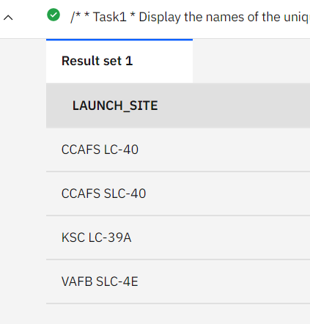
All Launch Site Names
SQL Query for finding the names of the unique launch sites:
SELECT DISTINCT (LAUNCH_SITE) FROM XTK78082.SPACEXTBL;
Query Explanation
Using the key word DISTINCT in the query means that it will only show Unique values in the LAUNCH_SITE column form table XTK78082.SPACEXTBL
SQL query results

Slide 25
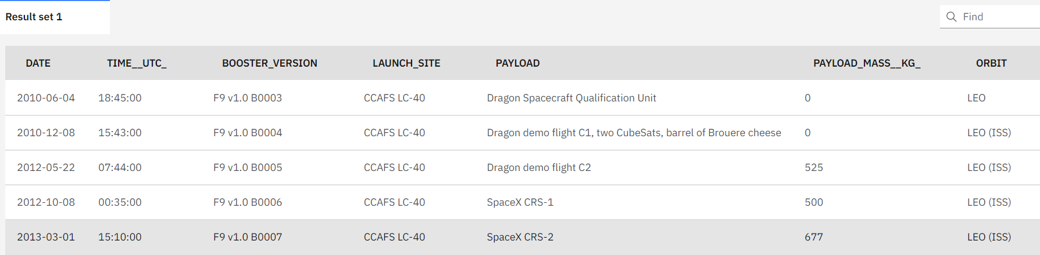
Launch Site Names Begin with 'CCA'
SQL Query for launch site name begin with ‘CCA’
SELECT * FROM XTK78082.SPACEXTBL WHERE LAUNCH_SITE LIKE 'CCA%' LIMIT 5;
Query Explanation
Using the keyword LIMIT 5 in the query means that it will only show 5records from table XTK78082.SPACEXTBL and LIKE keyword has a wild card with the words ‘CCA%’

Slide 26
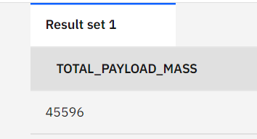
Total Payload Mass
SQL Query for total payload Mass by Customer NASA (CRS)
SELECT SUM(PAYLOAD_MASS__KG_) AS Total_Payload_Mass FROM XTK78082.SPACEXTBL WHERE CUSTOMER = 'NASA (CRS)';
Query Explanation
Using function SUM in the query summates the total in the column PAYLOAD_MASS__KG_ from table XTK78082.SPACEXTBL; WHERE clause set condition for only NASA (CRS) customers recodes be calculated.
Query Result

Slide 27
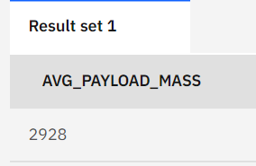
Average Payload Mass by F9 v1.1
SQL Query for average payload Mass carried by F9 v1.1
SELECT AVG(PAYLOAD_MASS__KG_) AS AVG_PAYLOAD_MASS FROM XTK78082.SPACEXTBL WHERE BOOSTER_VERSION = 'F9 v1.1'
Query Explanation
Using function AVG in the query calculate the average in the column PAYLOAD_MASS__KG_ from table XTK78082.SPACEXTBL; WHERE clause set condition for only F9 v1.1 Booster_version recodes be calculated.
Query Result

Slide 28
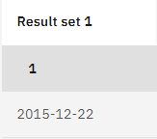
First Successful Ground Landing Date
SQL Query for first successful ground landing date
SELECT MIN(DATE) FROM XTK78082.SPACEXTBL WHERE LANDING__OUTCOME LIKE 'Success (ground pad)';
Query Explanation
Using function MIN in the query works out the minimum date in the column DATE from table XTK78082.SPACEXTBL; WHERE clause filters the dataset to only perform calculations on LANDING__OUTCOME Success ground landing.
Query Result

Slide 29
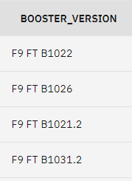
Successful Drone Ship Landing with Payload between 4000 and 6000
SQL Query for requiring question
SELECT BOOSTER_VERSION FROM XTK78082.SPACEXTBL WHERE LANDING__OUTCOME = 'Success (drone ship)' AND PAYLOAD_MASS__KG_ < 6000 AND PAYLOAD_MASS__KG_ >4000;
Query Explanation
WHERE clause filters the dataset to only perform calculations on LANDING__OUTCOME be Success (drone ship) and PAYLOAD_MASS__KG_ is in the range of (4000, 6000).
Query Result

Slide 30
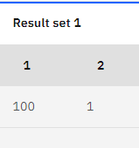
Total Number of Successful and Failure Mission Outcomes
SQL Query for total number of successful and failure mission:
SELECT * FROM (SELECT COUNT(MISSION_OUTCOME) FROM XTK78082.SPACEXTBL WHERE MISSION_OUTCOME LIKE '%Success%') AS Succ_Mission, (SELECT COUNT(MISSION_OUTCOME) FROM XTK78082.SPACEXTBL WHERE MISSION_OUTCOME LIKE '%Failure%') AS Fail_Mission;
Query Explanation
Subqueries are used here to produce the successful outcome and fail outcome.
Query Result

Slide 31
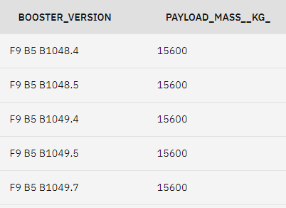
Boosters Carried Maximum Payload
SQL Query for boosters name for maximum payload mass
SELECT BOOSTER_VERSION, PAYLOAD_MASS__KG_ FROM XTK78082.SPACEXTBL WHERE PAYLOAD_MASS__KG_ = ( SELECT MAX(PAYLOAD_MASS__KG_) FROM XTK78082.SPACEXTBL) ORDER BY BOOSTER_VERSION;
Query Explanation
Using subquery to calculate maximum payload mass

Slide 32
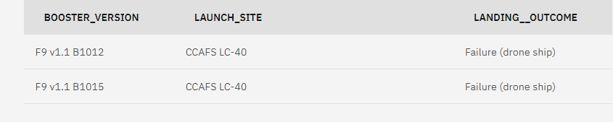
2015 Launch Records
SQL Query for 2015 failed landing Launch Recodes:
SELECT BOOSTER_VERSION, LAUNCH_SITE, LANDING__OUTCOME FROM XTK78082.SPACEXTBL WHERE LANDING__OUTCOME LIKE 'Failure (drone ship)‘ AND Date BETWEEN '2015-01-01' AND '2015-12-31';
Query Explanation
Used a combinations of the WHERE clause, LIKE, AND, and BETWEEN conditions to filter for failed landing outcomes in drone ship, their booster versions, and launch site names for year 2015
Query Result

Slide 33
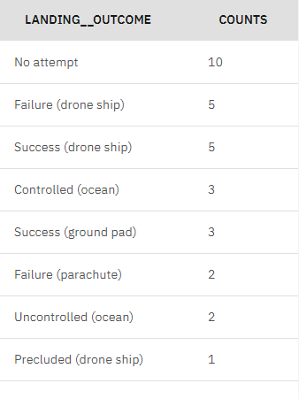
Rank Landing Outcomes Between 2010-06-04 and 2017-03-20
SQL Query for rank landing outcomes
SELECT LANDING__OUTCOME, COUNT(LANDING__OUTCOME) AS COUNTS FROM XTK78082.SPACEXTBL WHERE DATE BETWEEN '2010-06-04' AND '2017-03-20‘ GROUP BY LANDING__OUTCOME ORDER BY COUNTS DESC
Query Explanation
Using function COUNT counts recodes in LANDING__OUTCOME column; WHERE clause filters date between 2010-06-04 and 2017-03-20; Group by keyword groups the different landing outcome; Order by keyword ranks the outcomes.

Slide 34

Section 3

Slide 35
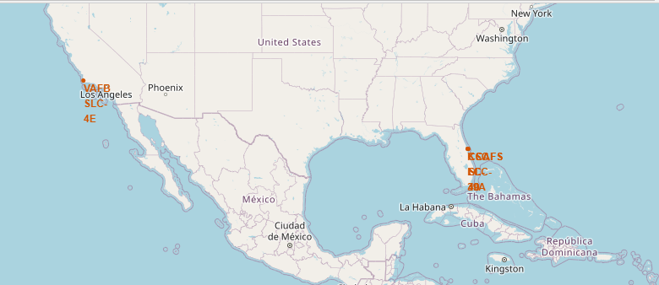
All Launch sites location in US map markers
The map shows the spaceX launch sites are in the United States of America coasts Florida and California

Slide 36
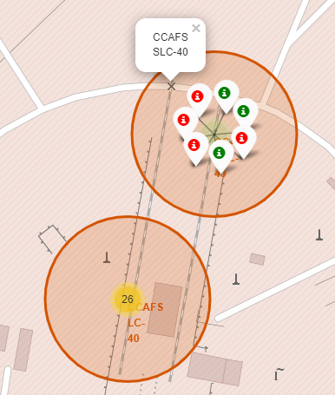
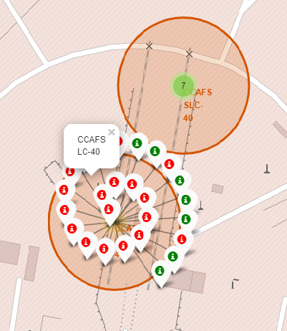
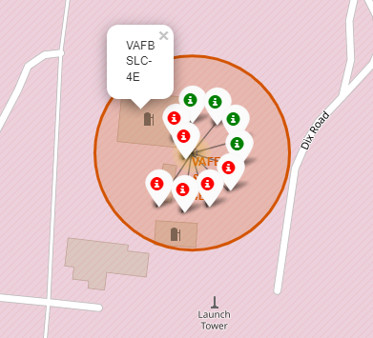
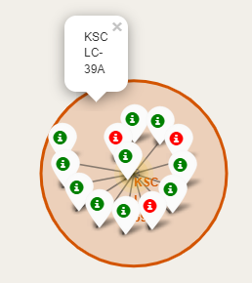
Mark the success/failed launches with color
California Launch Sites launch details
Florida Launch Sites launch details
A Green Marker shows a successful Launch
A Red Marker shows a failed launch

Slide 37
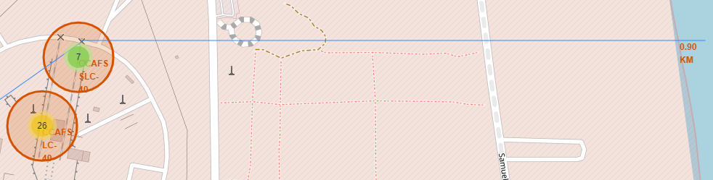
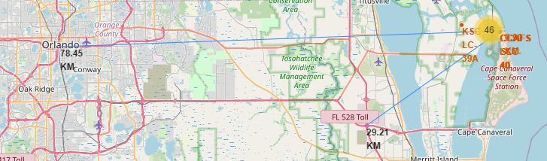
Launch Site (CCAFS-SLC-40) distance to Landmarks
Distance to coast is 0.90 km.
Distance to closest Highway is 29.21 km
Distance to Orlando is 78.45 km

Slide 38

Section 4

Slide 39
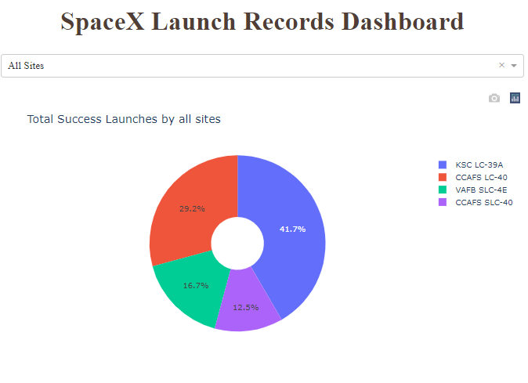
SpaceX Launch Dashboard: Total success launches by all sites
Pie chart shows the success percentage of all launch sites. KSC LC-39A has the most successful launches, 41.7% . CCAFS SLC-40 has the least successful launches, 12.5%

Slide 40
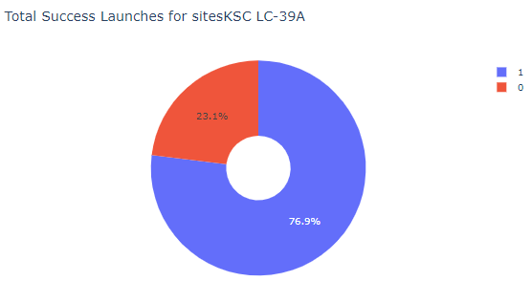
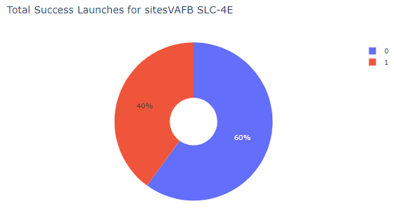
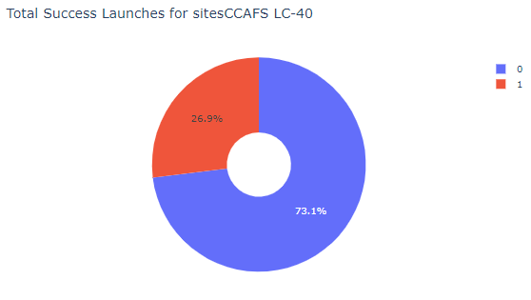
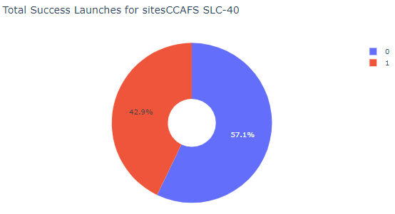
SpaceX Launch Dashboard: each site successful rates
Launch site | Successful rates
KSC LC-39A | 76.9
CCAFS LC-40 | 73.1
VAFB SKC-4E | 60.0
CCAFS SLC-40 | 57.1

Slide 41
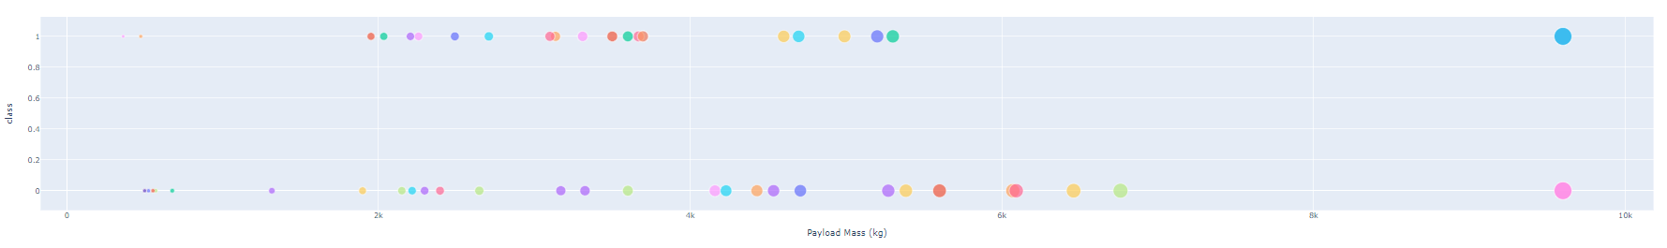
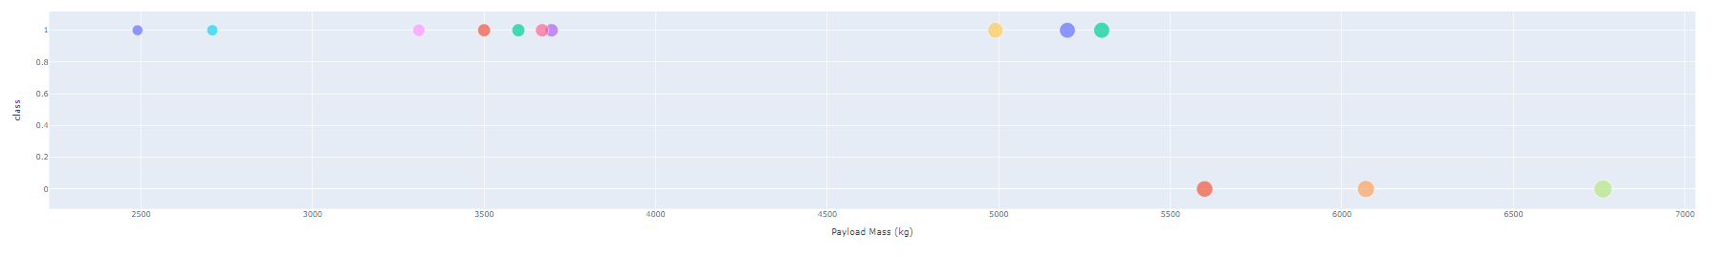
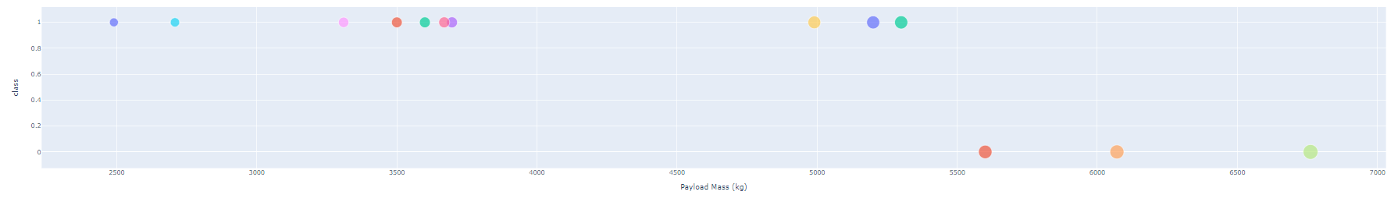
SpaceX Launch Dashboard: Payload Mass vs. Successful launch
All sites
0-10 Kg
KSC LC-39
0-7 Kg
KSC LC-39
2-7 Kg

Slide 42

Section 5

Slide 43
Classification Accuracy
Classification Accuracy using training data
Algorithm | Accuracy
Logistic Regression | 0.8464
Support vector machine | 0.8482
Decision Tree | 0.8732
KNN | 0.8482
The decision tree classifier has the best accuracy using the validation data.
The accuracy with the decision tree classifier on test data is 83.3%

Slide 44
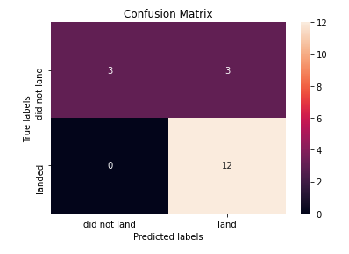
Confusion Matrix
The confusion matrix for the decision tree classifier shows that the classifier can distinguish between the different classes.
The major problem is the false positives .i.e., unsuccessful landing marked as successful landing by the classifier.

Slide 45
Conclusions
The Decision Tree Classifier Algorithm has the best accuracy for Machine learning for our dataset
The trend of launch successful rate is increasing as the time
KSC LC-39A has the most successful launches from all the sites
Orbit GEO, HEO, SSO, and ES-L1 have the best successful rate

Slide 46


